Slide 1
a
b
VL
VL
L
L
M
Human disturbance
H
M
VH
H
Before
Early
Late
After
VH
C
Not sampled
D
Dead
C + D
Photo only
Early
Late
Before
After
D + A
C + A
Heat stress time point

Slide 2
ITS2 type profile
Proportional abundance
Jul 2015
Jul 2017
Feb 2015
Mar 2016
Aug 2014
May 2015
Nov 2016
Jul 2015
Jul 2017
Jul 2015
Jul 2017
Feb 2015
Mar 2016
Aug 2014
May 2015
Nov 2016
Feb 2015
Mar 2016
Aug 2014
May 2015
Nov 2016
Expedition month

Slide 3
ITS2 type profile
Proportional abundance
Jul 2015
Jul 2017
Feb 2015
Mar 2016
Aug 2014
May 2015
Nov 2016
Jul 2015
Jul 2017
Jul 2015
Jul 2017
Feb 2015
Mar 2016
Aug 2014
May 2015
Nov 2016
Feb 2015
Mar 2016
Aug 2014
May 2015
Nov 2016
Expedition month

Slide 4
ITS2 type profile

Slide 5
a
Very Low
Low
Medium
b
Very Low
Low
Medium
1.00
0.75
0.50
0.25
0
High
Very High
High
Very High
Proportional abundance
1.00
0.75
0.50
0.25
0
Expedition month
ITS2 type profile

Slide 6
a
b
P = 0.433
n = 44
P < 0.001
n = 59
Proportion bleached
Human disturbance

Slide 7
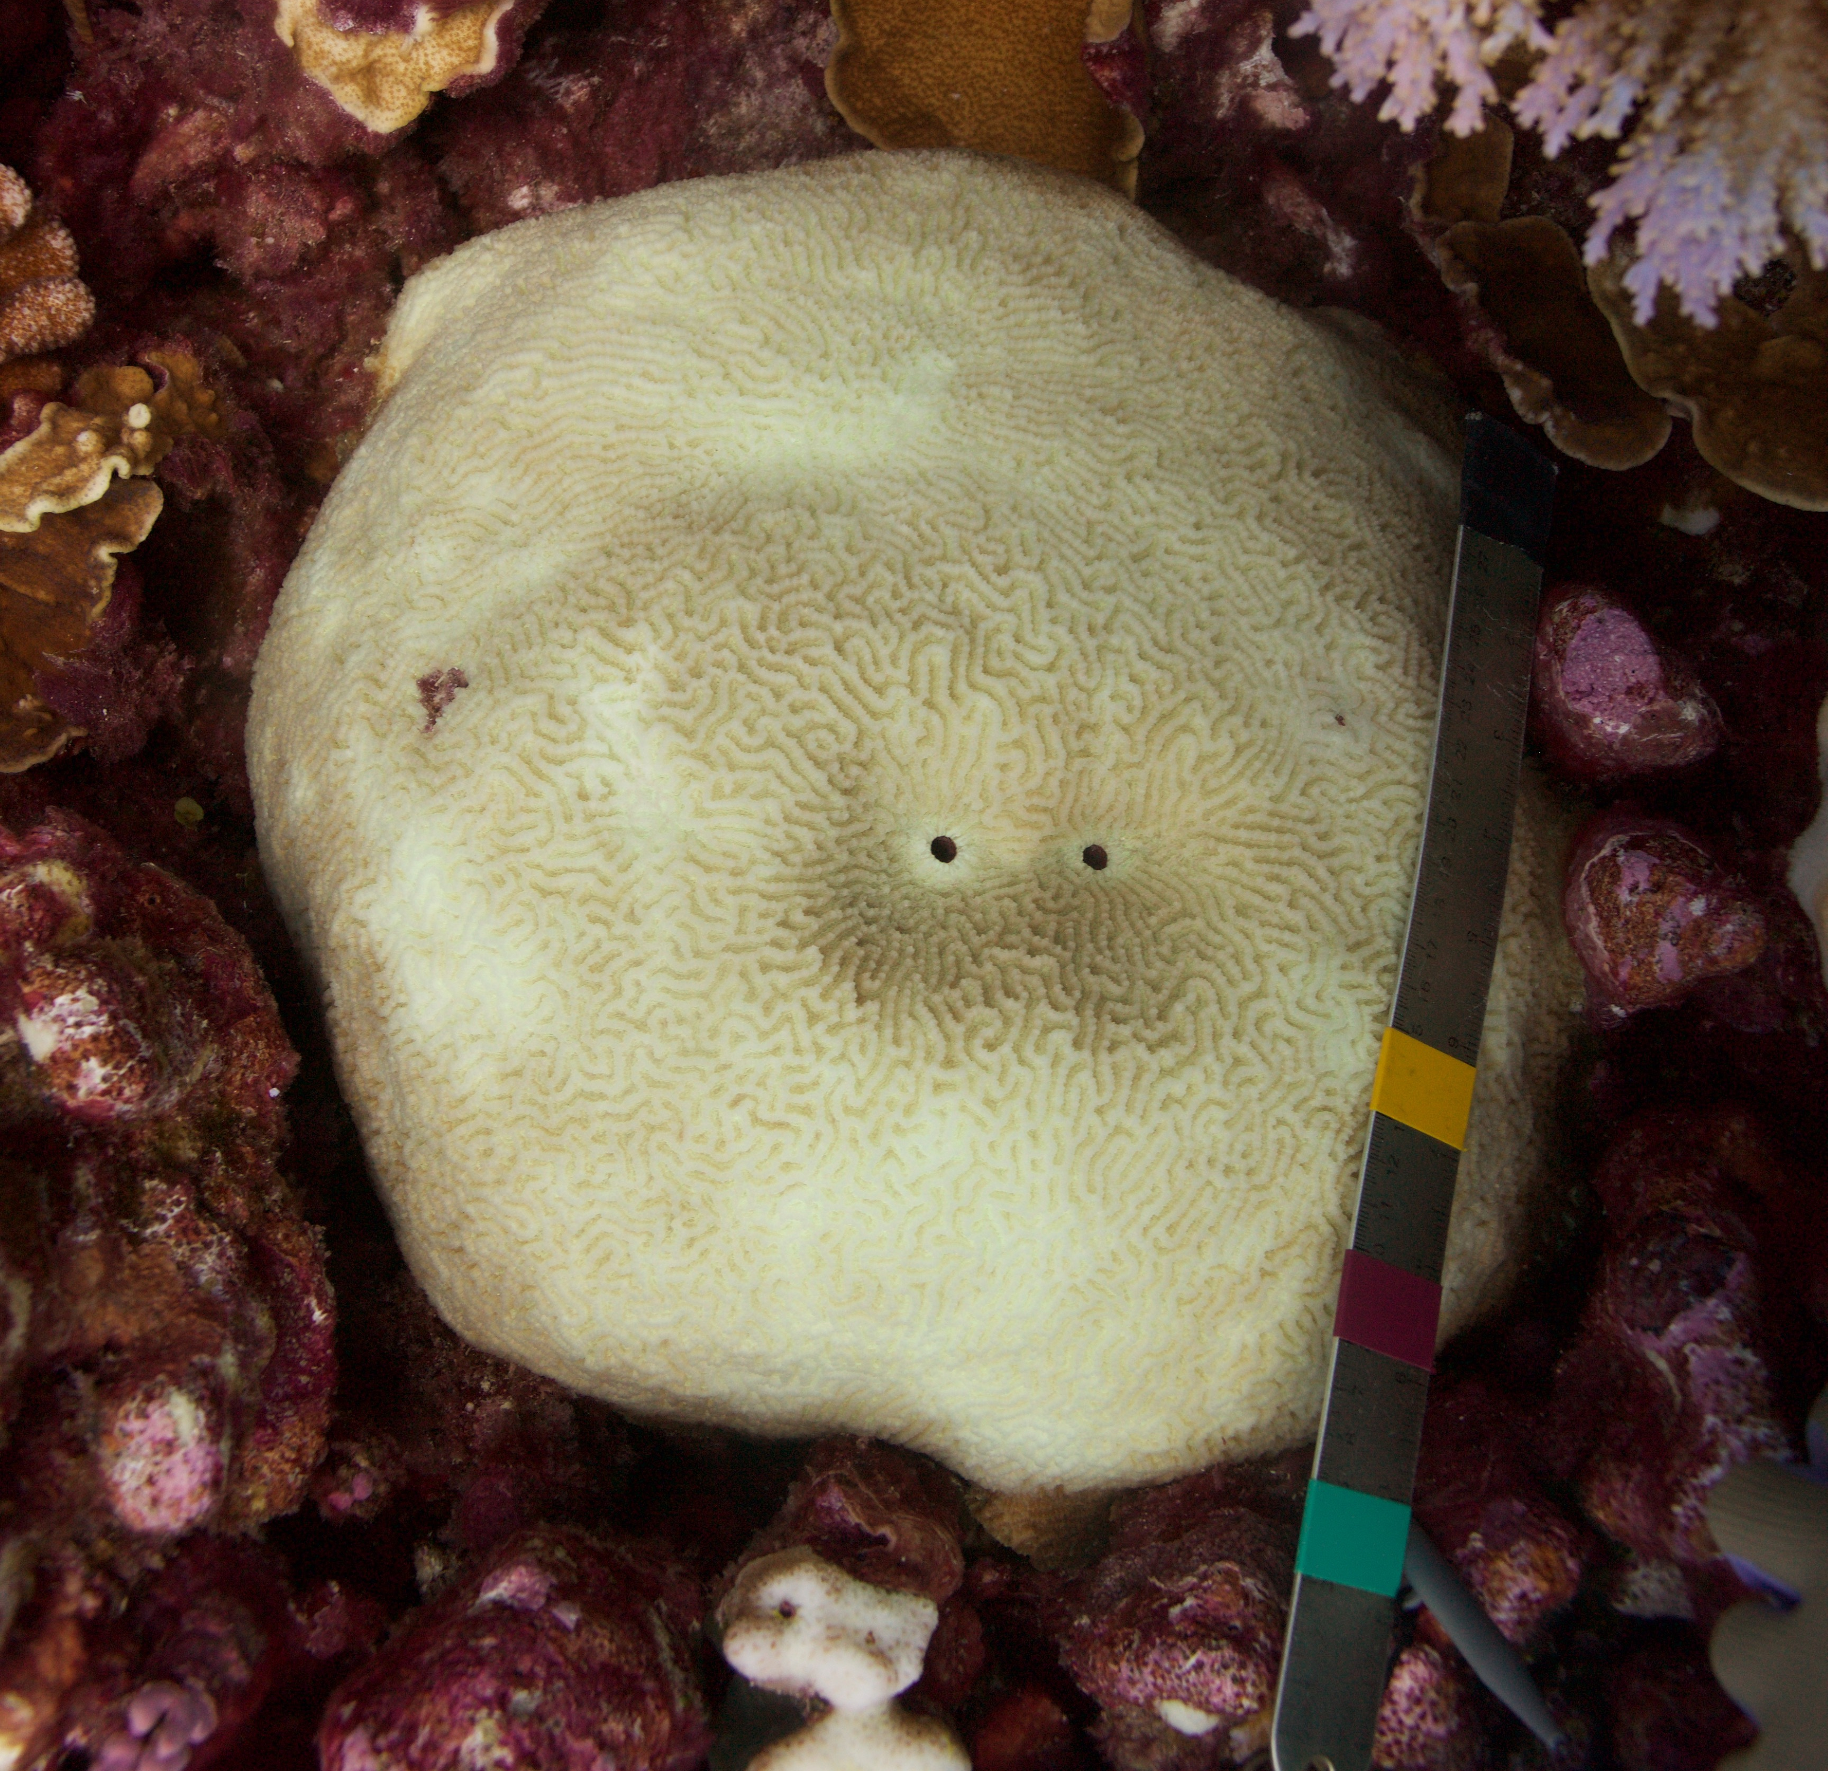
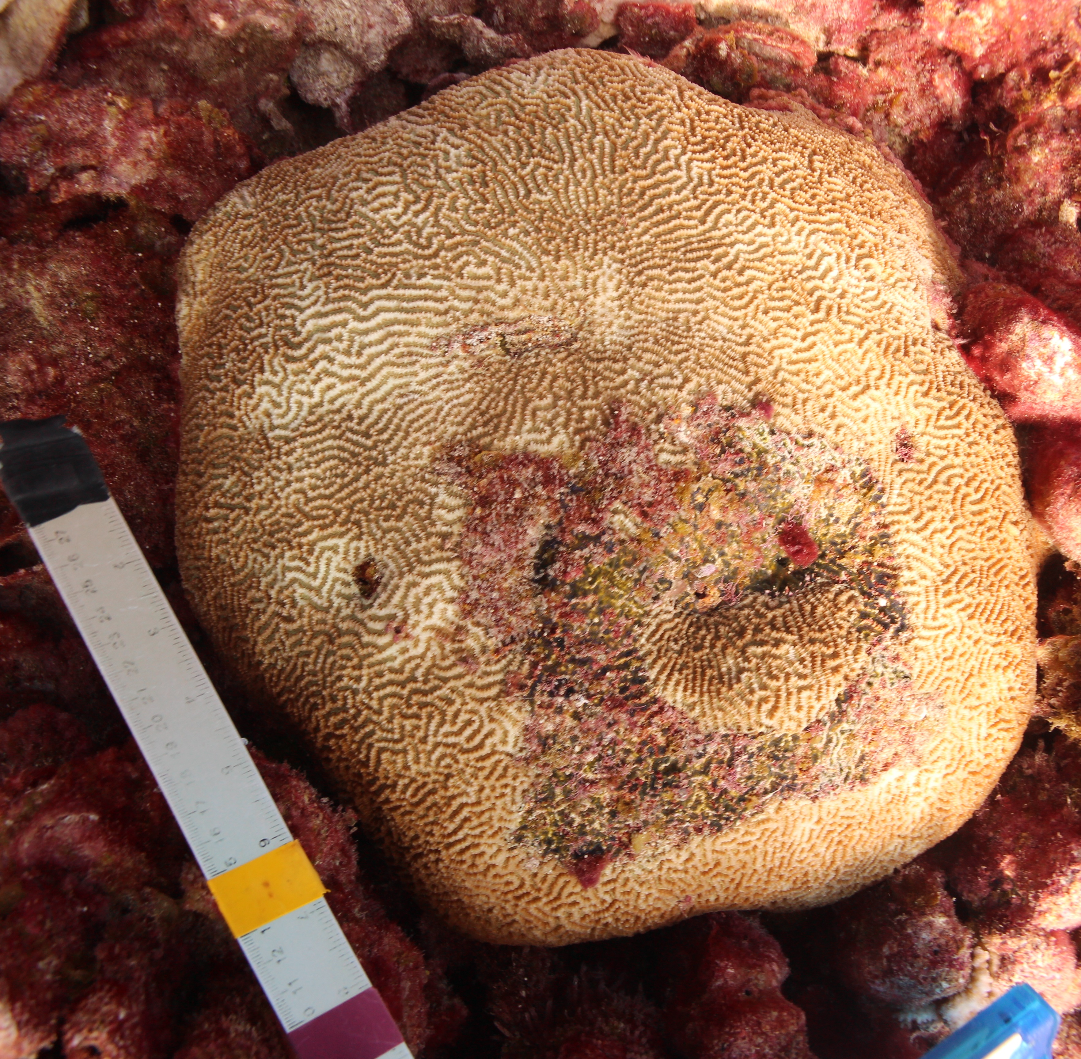
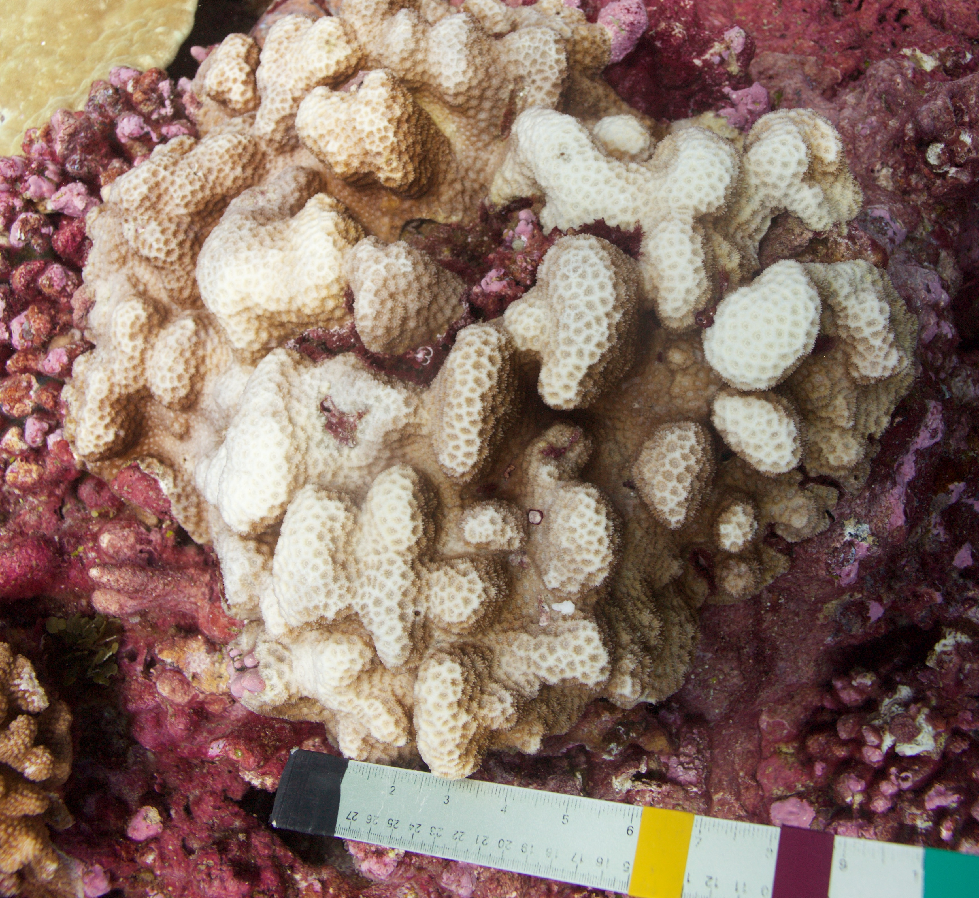
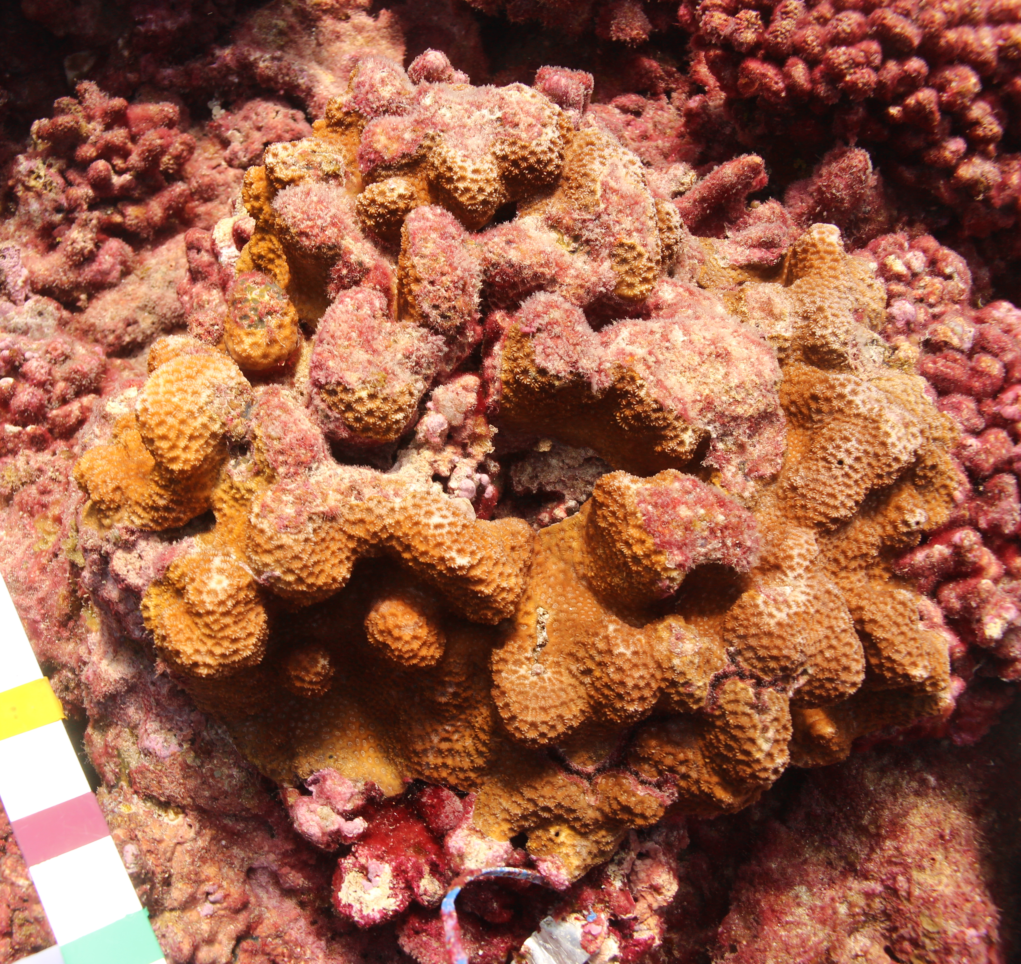
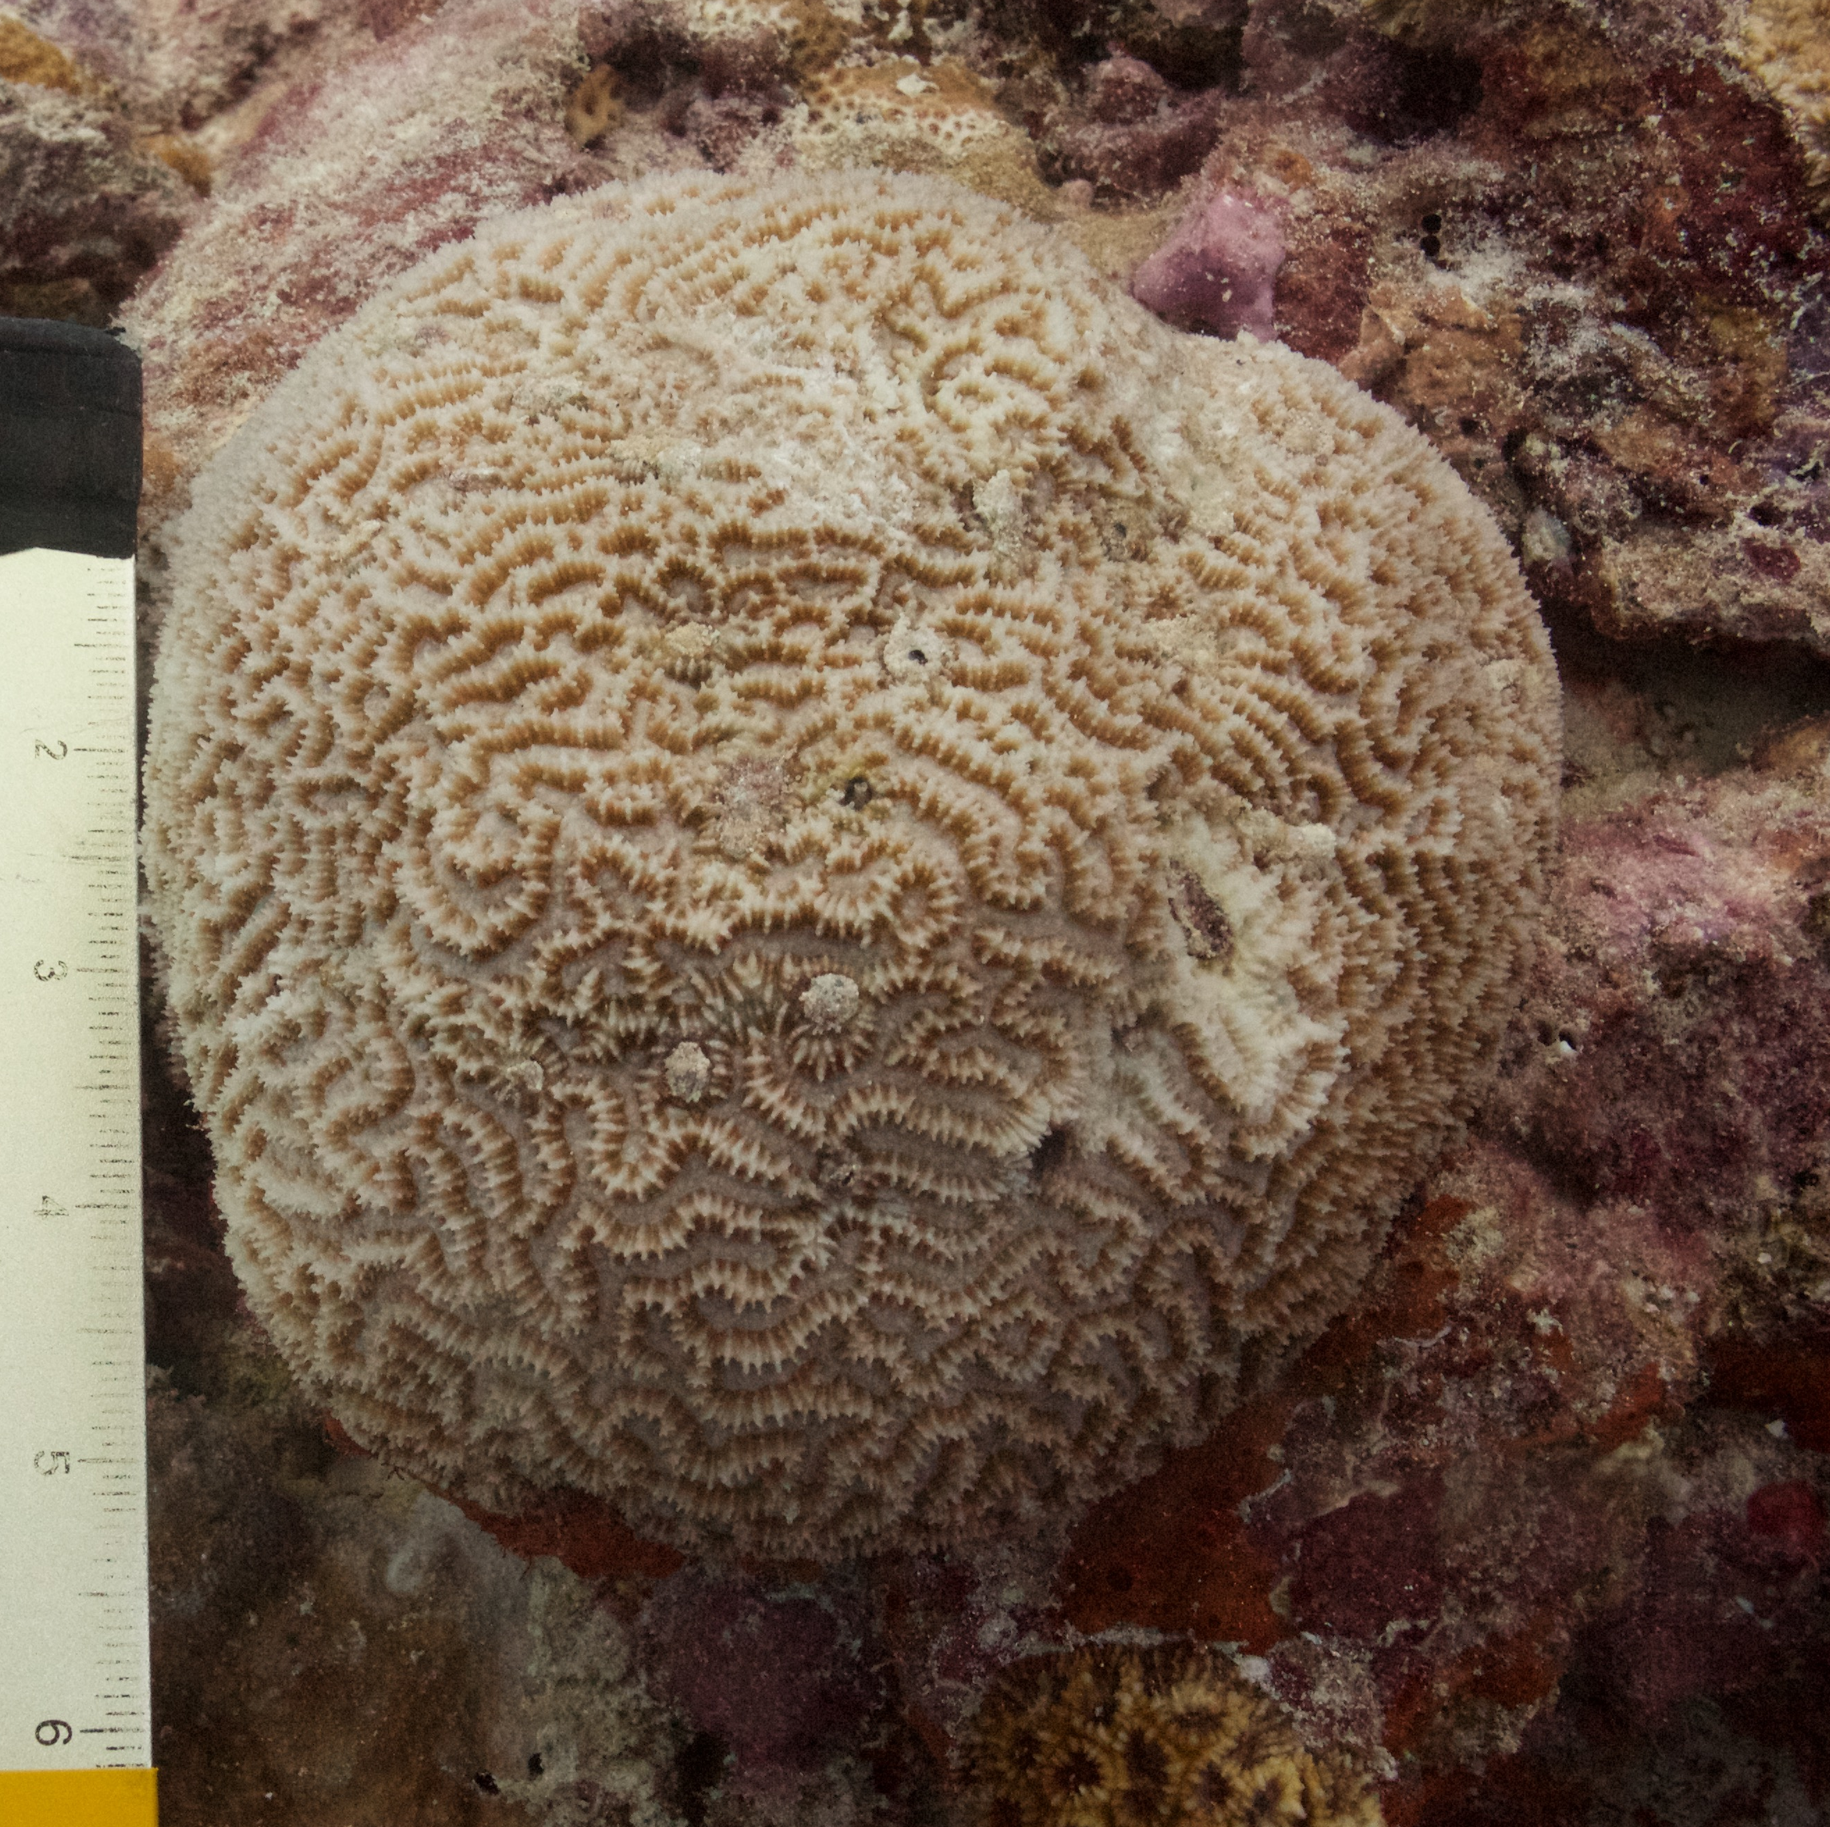
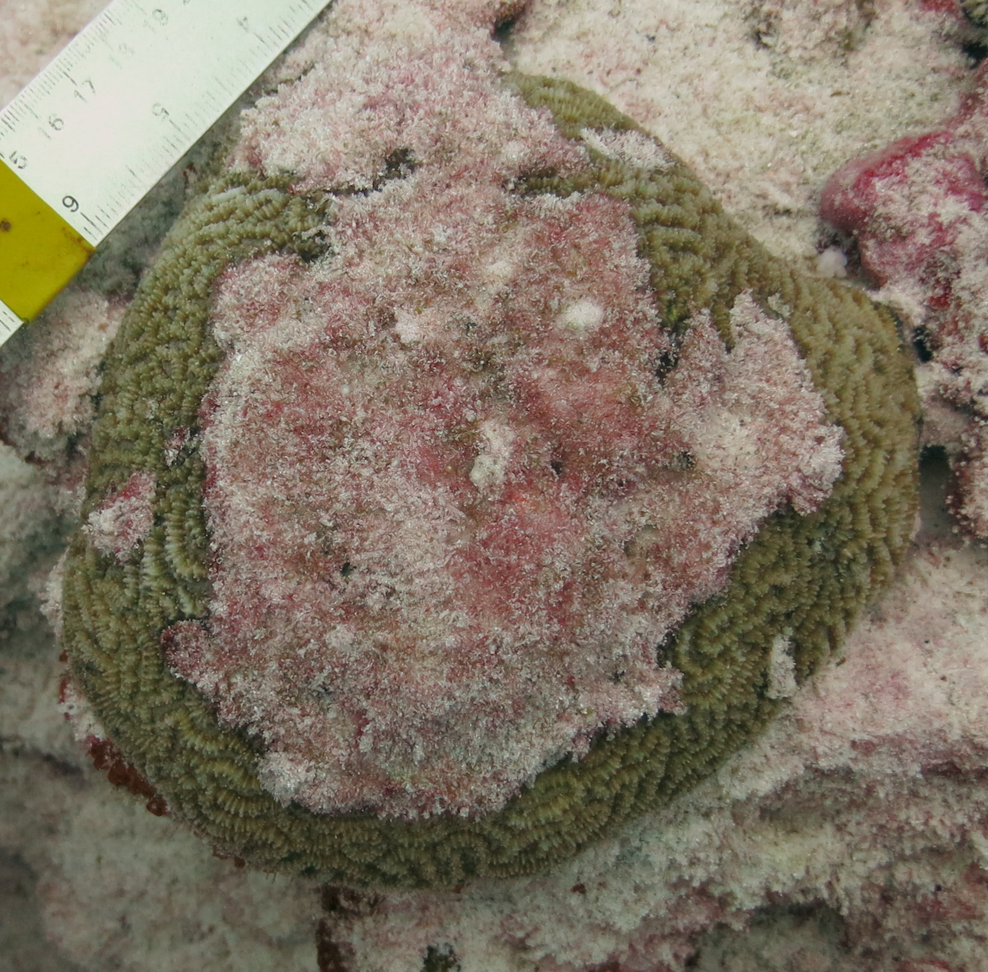
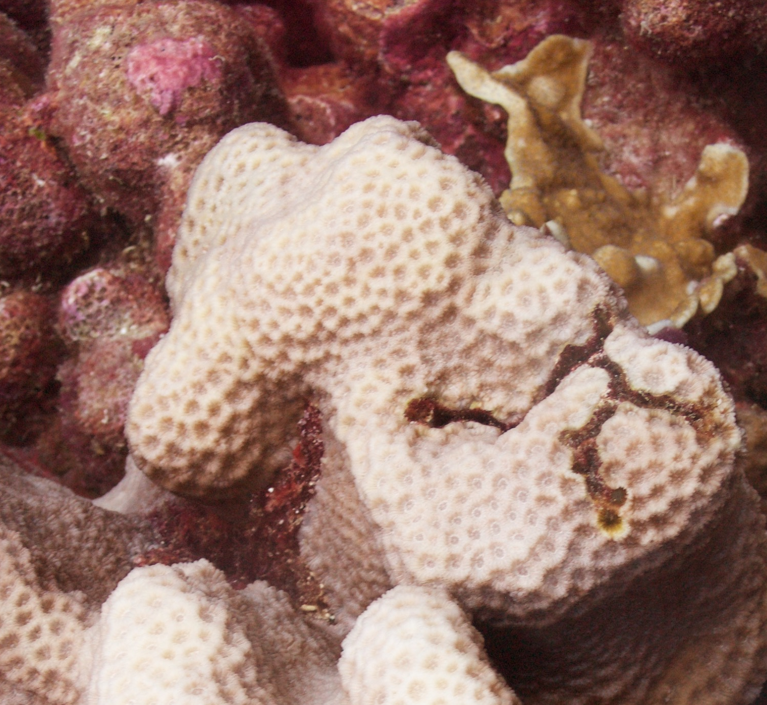
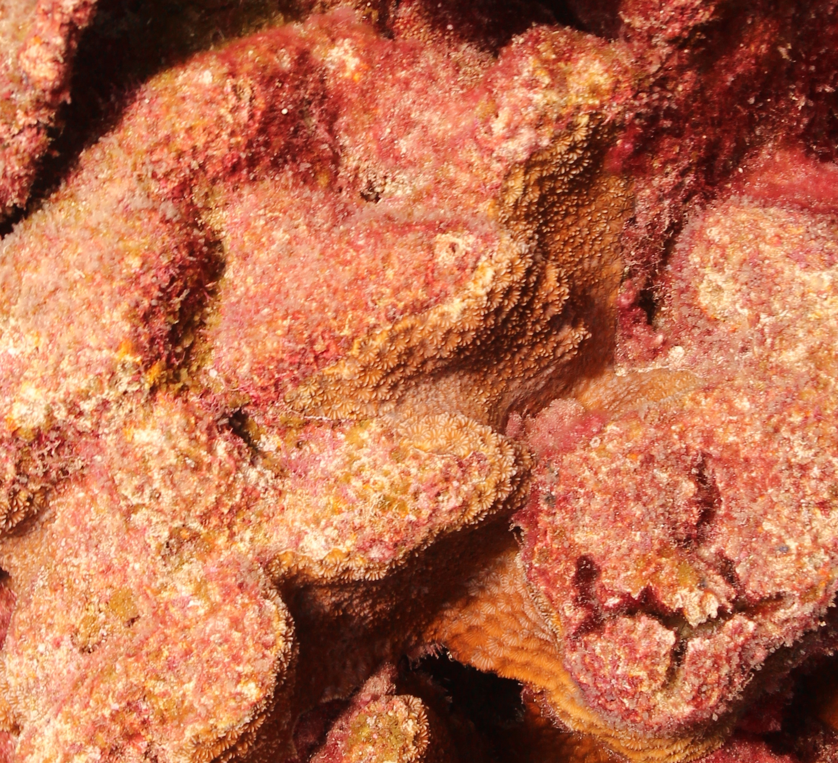
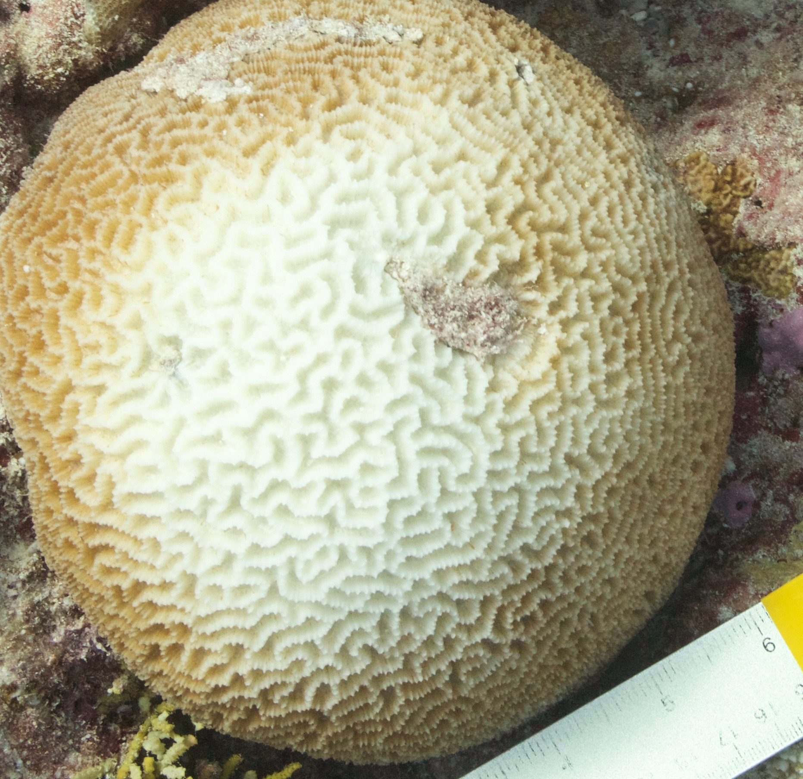
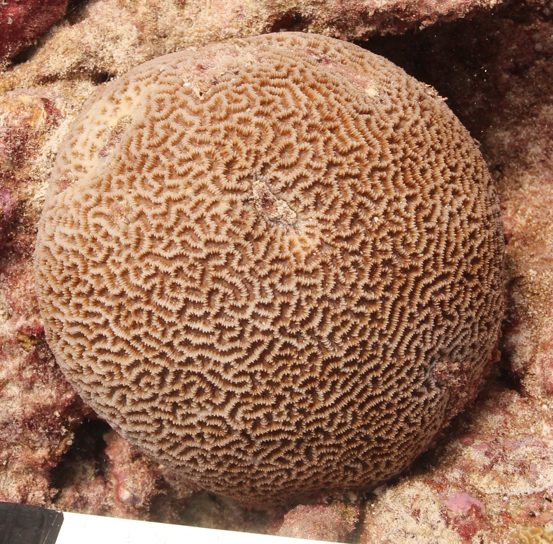
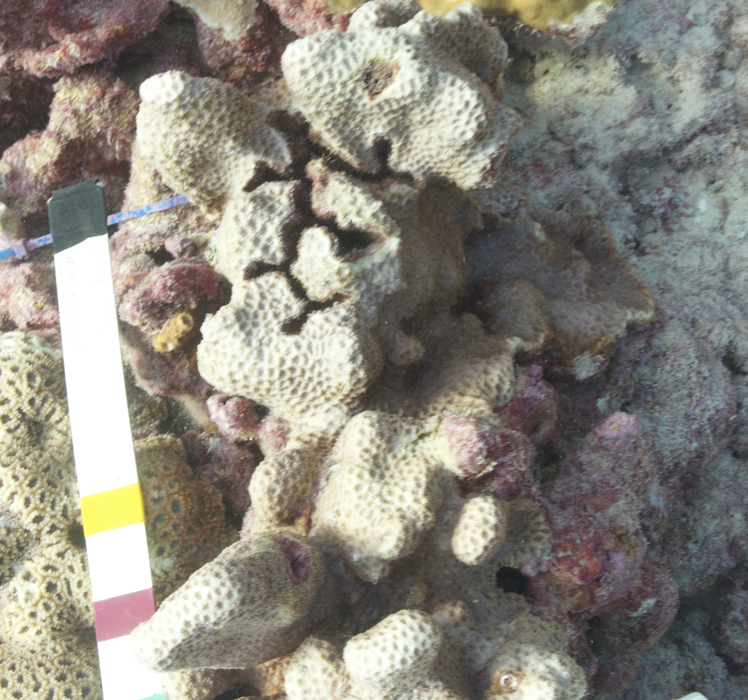
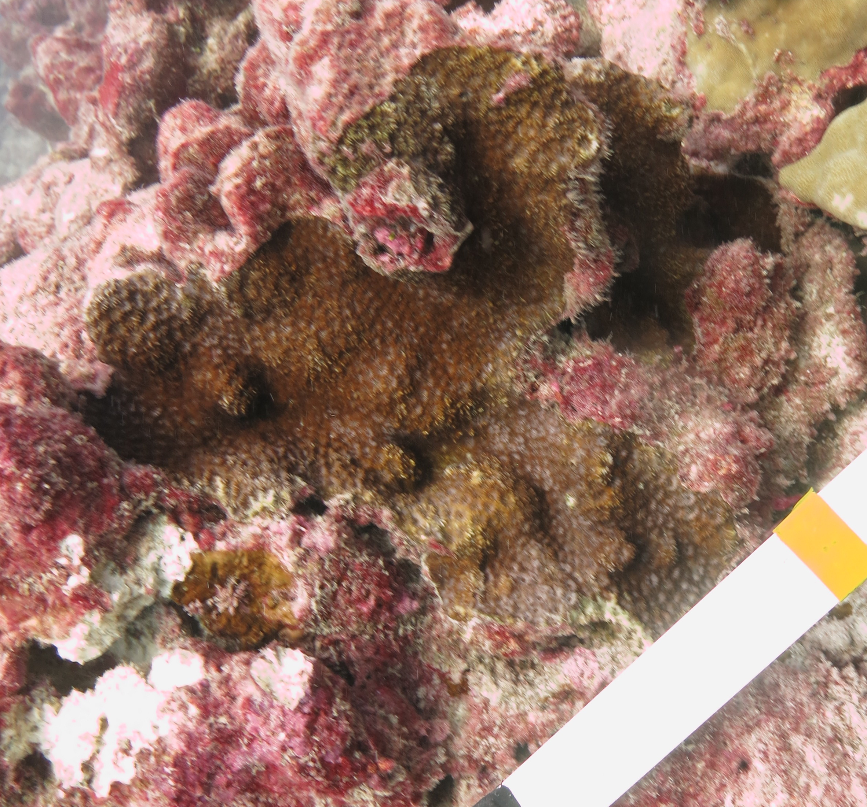
Early
Late
Early
Late
a
b
a
b
c
d
c
d
e
f
e
f

Slide 8
Early
Late
Early
Late
a
b
g
h
c
d
i
j
e
f
k
l

Slide 9
a
1
0.75
0.50
0.25
0
May 2015
July 2015
November 2015
March 2016
Proportion of random points
b
1
0.75
0.50
0.25
0
May 2015
July 2015
November 2015
March 2016

